Slide 1
CIS041-3 Advanced Information Technology
Machine Learning (ML) and Natural Language Processing (NLP)
Gangmin Li
(Office hours: 13:00-17:00 every Friday)

Slide 2
What we have learnt
AI as the most disruptive technology
AI has impact on IT in general – Automatic/intelligent access, process and make use of information!
Two key underlay technology of AI –
Neural Networks (Brain) and Machine learning (approach)
Neural networks impact on IT with some Pretrained language models (trained NN – Mind)

Slide 3
ML - Outline
Machine Learning
What is ML?
How does it work?
Types of ML
NLP
Word2vec (representation)
Language model
Matching (NN)

Slide 4
Machine learning
The 2nd distinct character of New AI (apart from ANN) …

Slide 5
What is Machine Learning?
Machine learning (ML): a part of artificial intelligence devoted to understanding and building models that can 'learn’ from data and remember patterns in data and to perform on different tasks that otherwise is impossible.
Machine learning involves creating a model, which is trained on some training data and then can process additional data to make predictions.
Various types of models have been created and researched for building machine learning systems.

Slide 6
Wikiwand
Icon of machine learning appeared every term related with ML
What is it?
Kernel Machine

Slide 7
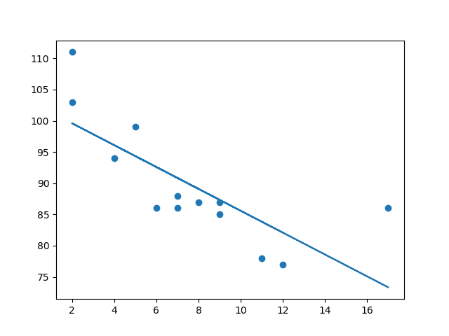
A classical ML example - Linear Regression
Regression: The term regression is used when you try to find the relationship between variables.
Linear Regression: Linear regression uses the relationship between the data-points to draw a straight line through all them. This line can be used to predict future values.

Slide 8
How to separate them?
An ancient story …
SVM fight with devil to save his lover

Slide 9
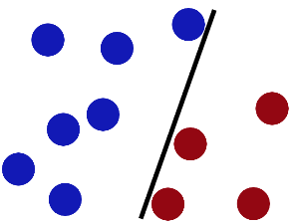
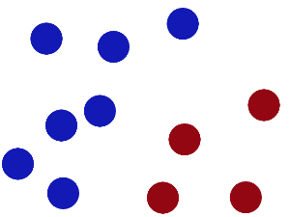
Fight with the Devil …
Devil ask SVM to separate them with a stick and … still works after more balls added …

Slide 10
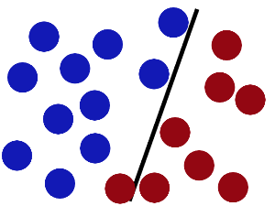
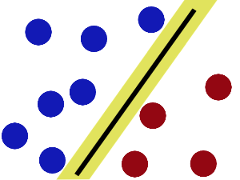
Optimization problem
SVMs try to put the stick in the best possible place by having as big a gap on either side of the stick as possible.

Slide 11
Support Vector Machine (SVM)
A supervised learning model used in classification and regression analysis
H1 does not work
H2 works with a tight margin
H3 is the best because it has the largest margin

Slide 12
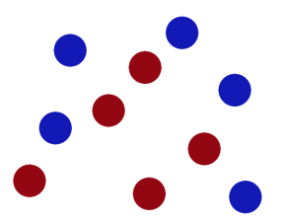
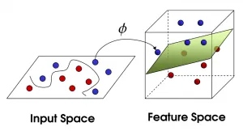
Non-linear solution (Kernel)

Slide 13
Learning as an optimization problem
Consider a simple neural network with two input units, one output unit and no hidden units, each neuron uses a linear output that is the weighted sum of its input.
$$w_{1}$$
$$x_{1}$$
y
$$w_{1}$$
$$x_{2}$$

Slide 14
Loss function
Initially, before training, the weights will be set randomly.
Then the neuron learns from training examples, which in this case consist of a set of tuples , where and are the inputs to the network and t is the correct output (the output the network should produce given those inputs, when it has been trained).
The initial network, given will compute an output y that likely differs from t (given random weights).
A loss function is used for measuring the discrepancy between the target output t and the computed output y.
For regression analysis problems the squared error can be used as a loss function, for classification the categorical cross entropy can be used.

Slide 15
Loss function https://www.wikiwand.com/en/Backpropagation
As an example, let us consider (a regression problem) using the square error as a loss:
Here, E is the error.
So the training of the model (NN) is to find the smallest E.
Consider a single training case: (1, 1, 0). the input are 1 and 1 respectively and the correct output, t is 0. We know,
, So

Slide 16
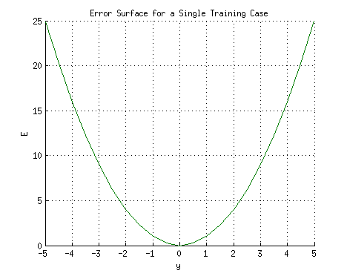
Loss function (error) with y
If we plot the relation between the network's output y (on the horizontal axis) and the error E (on the vertical axis), the result is a parabola.

Slide 17
Loss function (error) with y
From the graph …
The minimum of the parabola corresponds to the output y which minimizes the error E.
So, considering all the possible training set. Loss function E will be in a form of a parabolic cylinder with its base directed along
So, weights that satisfy $w_{1}=−w_{2}$ minimize the loss function,

Slide 18
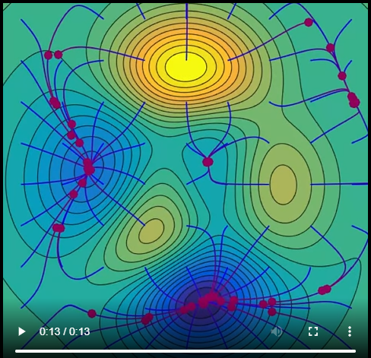
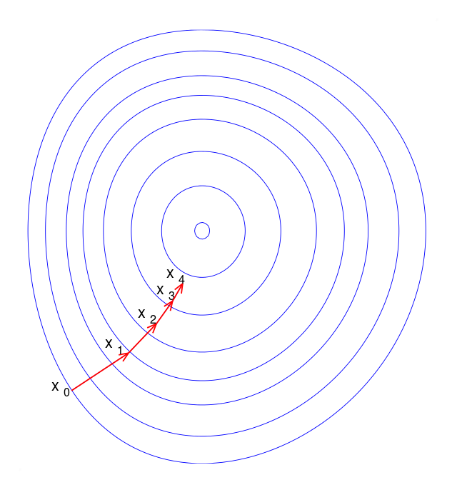
Find minimise error: Gradient descent
A first-order iterative optimization algorithm for finding a local minimum of a differentiable function.
A person is stuck in the mountains and is trying to get down.
https://upload.wikimedia.org/wikipedia/commons/transcoded/4/4c/Gradient_Descent_in_2D.webm/Gradient_Descent_in_2D.webm.480p.vp9.webm
Two factors: step size and descent direction
Notes:
A person is stuck in the mountains and is trying to get down (i.e., trying to find the global minimum). There is heavy fog such that visibility is extremely low. Therefore, the path down the mountain is not visible, so they must use local information to find the minimum. They can use the method of gradient descent, which involves looking at the steepness of the hill at their current position, then proceeding in the direction with the steepest descent (i.e., downhill). If they were trying to find the top of the mountain (i.e., the maximum), then they would proceed in the direction of steepest ascent (i.e., uphill). Using this method, they would eventually find their way down the mountain or possibly get stuck in some hole (i.e., local minimum or saddle point), like a mountain lake. However, assume also that the steepness of the hill is not immediately obvious with simple observation, but rather it requires a sophisticated instrument to measure, which the person happens to have at the moment. It takes quite some time to measure the steepness of the hill with the instrument, thus they should minimize their use of the instrument if they wanted to get down the mountain before sunset. The difficulty then is choosing the frequency at which they should measure the steepness of the hill so not to go off track.
In this analogy, the person represents the algorithm, and the path taken down the mountain represents the sequence of parameter settings that the algorithm will explore. The steepness of the hill represents the slope of the function at that point. The instrument used to measure steepness is differentiation. The direction they choose to travel in aligns with the gradient of the function at that point. The amount of time they travel before taking another measurement is the step size.

Slide 19
ML Types
Supervised learning: The computer is presented with example inputs and their desired outputs, given by a "teacher", and the goal is to learn a general rule that maps inputs to outputs.
Unsupervised learning: No labels are given to the learning algorithm, leaving it on its own to find structure or patterns in its input.
Reinforcement learning: A computer program interacts with a dynamic environment in which it must perform a certain goal (such as driving a vehicle). As it navigates its problem space, the program is provided feedback that's analogous to rewards, which it tries to maximize.

Slide 20
Learning process: (Iterative)
Aim: build (or set parameters of) a mathematical model ( or NN) through a set of training data that contains both the inputs and the desired outputs.
The training data is generally represented by a matrix and each training example is represented by an array or vector (so it is also called a feature vector).
Through iterative optimization of an objective function by test dataset, supervised learning learn a function that can be used to predict the output associated with new inputs.
An algorithm that improves the accuracy of its outputs or predictions over time is said to have learned to perform that task. (classification, regression, similarity learning for ranking and recommendation, ….)

Slide 21
NLP – ML as an advanced IT
http://mccormickml.com/2016/04/19/word2vec-tutorial-the-skip-gram-model/
https://towardsdatascience.com/a-gentle-introduction-to-calculating-the-tf-idf-values-9e391f8a13e5
Stanford cs224. NLP and word Embedding

Slide 22
What is NLP?
Natural language processing (NLP) is a field of machine learning in which machines learn to understand natural language as spoken and written by humans, instead of the data and numbers normally used to program computers. This allows machines to recognize language, understand it, and respond to it, as well as create new text and translate between languages. Natural language processing enables familiar technology like chatbots and digital assistants like Siri or Alexa.

Slide 23
How machine learning used NLP?
Advanced Representation Models
word embedding (in 2013)
language models (in 2018): Bert, GTP2/3,

Slide 24
Word Embedding

Slide 25
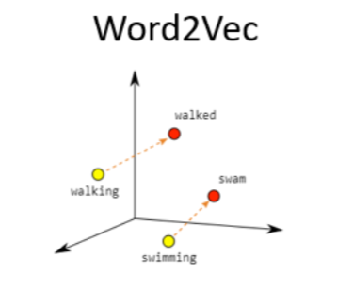
Word Embedding
A representation of words, typically in the form of a real-valued vector that encodes the meaning of the word such that the words that are similar in meaning will be closer in the vector space.
Typical method is Word2Vec.
Software: Mikolov's Word2vec, Stanford University's GloVe, AllenNLP’s ELMo, BERT, fastText,

Slide 26
Word2vec
Published 2013, Mikolov et al. At Google
(https://arxiv.org/pdf/1312.5542.pdf, https://arxiv.org/pdf/1309.4168v1.pdf)
Two layer neural networks
Once trained, can detect synonymous words or suggest additional words for a partial sentence.
Word2vec represents changed the word embedding to “the weights of a neural network that are adjusted to minimize some loss, depending on the task.
Embedding had become a neural network algorithm.

Slide 27
Examples
words asparagus, pidgey and yellow on Ebow trained on Wikipedia
“king” (GloVe vector trained on Wikipedia):
[ 0.50451 , 0.68607 , -0.59517 , -0.022801, 0.60046 , -0.13498 , -0.08813 , 0.47377 , -0.61798 , -0.31012 , -0.076666, 1.493 , -0.034189, -0.98173 , 0.68229 , 0.81722 , -0.51874 , -0.31503 , -0.55809 , 0.66421 , 0.1961 , -0.13495 , -0.11476 , -0.30344 , 0.41177 , -2.223 , -1.0756 , -1.0783 , -0.34354 , 0.33505 , 1.9927 , -0.04234 , -0.64319 , 0.71125 , 0.49159 , 0.16754 , 0.34344 , -0.25663 , -0.8523 , 0.1661 , 0.40102 , 1.1685 , -1.0137 , -0.21585 , -0.15155 , 0.78321 , -0.91241 , -1.6106 , -0.64426 , -0.51042 ]

Slide 28
Examples
Illustrated Word2vec
https://youtu.be/ISPId9Lhc1g

Slide 29
How Word2Vec works?
Two Neural Networks models both have two layers.
CBOW (Continuous bag of words model) and Skip-gram
The model is trained by iterates over substantial corpus (such as Wikipedia) of a text to learn the relationship among the words. It uses cosine similarity metric to identify the similarity among the words.
Once trained, the model can captures both syntactic and semantic similarities between the words.
Examples:
Vector(“King”)-Vector(“Man”) = Vector(“Queen”)-Vector(“Woman).
vec(‘Rome’) = vec(‘Paris’) – vec(‘France’) + vec(‘Italy’).

Slide 30
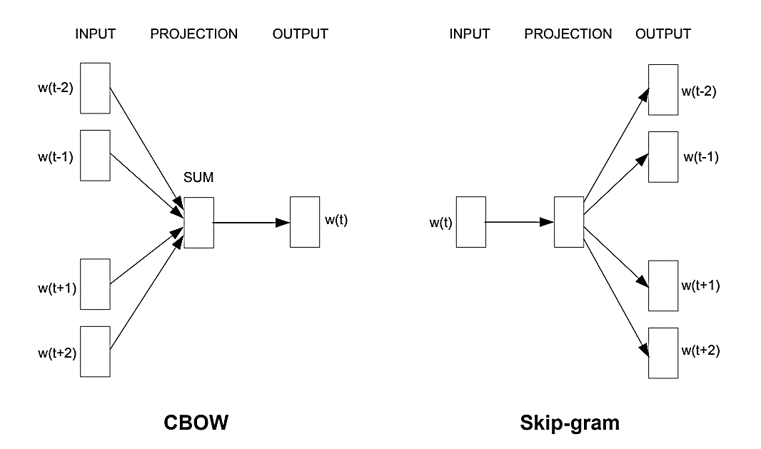
Two Word2vec models: CBOW & Skip-gram
https://arxiv.org/pdf/1309.4168v1.pdf

Slide 31
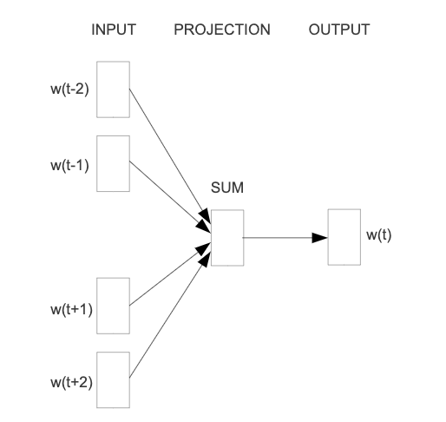
CBOW
CBOW model predicts the target word according to its context (neighbours on the left and the right). The context is represented as a bag of the words contained in a fixed size window around the target word.
On the left graph, the window size is 5. The traing sample will be the middle word w(t), which will be the target word and the left two words w(t-2), W(t-1) plus the right two words w(t+1), W(t+2) will be the dependents
Hope can set you free …

Slide 32
CBOW Neural Networks
The input layer consists of the “one-hot” encoded input context words {x1, …, xC} for a word window of size C and vocabulary of size V.
The hidden layer is an N-dimensional vector h.
The output layer is output word y in the training example which is also “one-hot” encoded with V dimensions.
The one-hot encoded input vectors are connected to the hidden layer via a V×N weight matrix W
The hidden layer is connected to the output layer via a N×V weight matrix W′.
V-dim

Slide 33
Forward Propagation
How the output is computed from the input?
The first step is to evaluate the output of the hidden layer h. it is computed by
it is the average of the input vectors weighted by the matrix W.
Next we compute the inputs to each node in the output layer

Slide 34
Forward Propagation
How the output is computed from the input?
Finally we compute the output of the output layer. The output is obtained by passing the input through the soft-max function.
The purpose of the training is to learn the weight matrices: W and W’

Slide 35
Learning the Weight Matrices
Backpropagation:
We begin with randomly initialized values of W and W’.
We then sequentially feed training examples into our model and observe the error which is some function of the difference between the expected output and the actual output.
We then compute the gradient of this error with respect to the elements of both weight matrices and correct them in the direction of this gradient.
This general optimization procedure is known as stochastic gradient descent (or SGD).

Slide 36
Learning the Weight Matrices
Define the loss function: The objective is to maximize the conditional probability of the output word given the input context
Where $j^{∗}$is the index of the actual output word.
The next step is to derive the update equation for the hidden-output layer weights W’, then derive the weights for the input-hidden layer weights W

Slide 37
Updating the hidden-output layer weights
The first step is to compute the derivative of the loss function with respect to the input to the node in the output layer
where if otherwise . This is simply the prediction error of node in the output layer.
Next we take the derivative of E with respect to the output weight using the chain rule.

Slide 38
Updating the hidden-output layer weights
Now that we have the gradient with respect to an arbitrary output weight , we can define the stochastic gradient descent equation.
or

Slide 39
Updating the input-hidden layer weights
We can do the same for the input weights $w_{ij}.$
The first step is to compute the derivative of E with respect to an arbitrary hidden node (again using the chain rule).
where the sum is do to the fact that the hidden layer node is connected to each node of the output layer and therefore each prediction error must be incorporated.

Slide 40
Updating the input-hidden layer weights
The next step is to compute the derivative of E with respect to an arbitrary input weight .
Where is an N-dimensional vector of elements from $i=1, …, N.$ However, since the inputs x are one-hot encoded, only one row of the matrix will be nonzero.

Slide 41
Updating the input-hidden layer weights
The final stochastic gradient descent equation for the input weights is

Slide 42
Training CBOW with example
Initially, select a corpus (Cambridge dictionary containts13 million words, to cover all these words we may needs large collection of the literature)
Let us consider the training corpus having the following sentences:
“the dog saw a cat”,
“the dog chased the cat”,
“the cat climbed a tree”
The corpus vocabulary has eight words.
“the”, “dog”, “saw”, “a”, “cat”, “chased”, “claimed”, “tree”.

Slide 43
“one-hot” encode
The eight words of the corpus vocabulary can be ordered and encoded as:
a [1, 0, 0, 0, 0, 0, 0, 0]
Cat [0, 1, 0, 0, 0, 0, 0, 0]
Chased [0, 0, 1, 0, 0, 0, 0, 0]
Claimed [0, 0, 0, 1, 0, 0, 0, 0]
dog [0, 0, 0, 0, 1, 0, 0, 0]
saw [0, 0, 0, 0, 0, 1, 0, 0]
the [0, 0, 0, 0, 0, 0, 1, 0]
tree [0, 0, 0, 0, 0, 0, 0, 1]

Slide 44
One-hot vector issues
It is simple but,
The size of vectors depends on the size of vocabulary (which can be huge e,g, 13 million).
The wastage of space and increases algorithm complexity exponentially
Making “transfer-learning” to a model almost impossible.
it would require to re-train the whole model again if adding/removing words from vocabulary
It loss the contextual meaning of the words. It is contradict to the purpose of word embedding.

Slide 45
The Neural Networks
For the given example, our neural network will have eight input neurons and eight output neurons (vector will have a length 8).
Let us assume that we decide to use three neurons in the hidden layer. This means that W and W’ will be 8×3 and 3×8 matrices, respectively.
Before training begins, the two weight matrices are initialized to small random values.

Slide 46
The Neural Networks
For the given example, our neural network will have eight input neurons and eight output neurons (vector will have a length 8).
Let us assume that we decide to use three neurons in the hidden layer. This means that W and W’ will be 8×3 and 3×8 matrices, respectively.
Before training begins, the two weight matrices are initialized to small random values.

Slide 47
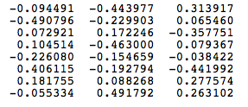
Weight matrices W and W’
For the illustration, let us assume W and W’ to be initialized to the following values:
W =
W’ =

Slide 48
Training: {the, saw} -> dog
Suppose we set a window size C=3. So we can have a list of training samples. For example, from sentence,
We can have,
{the, saw} -> dog; {dog, a}->saw, {saw, cat}->a, …
Now we want the network to learn relationship between the words “the”, “saw” and “dog”. That is, the network should show a high probability for “dog” when “the”, “saw” is inputted to the network.
“the dog saw a cat”,

Slide 49
The training samples
In this case, the input vector X will be
[0 0 0 0 0 0 1 0]^{t} and [0 0 0 0 0 1 0 0]^{t}
Notice that the word “the” one-hot vector is
[0 0 0 0 0 0 1 0]
and the word “saw” is
[0 0 0 0 0 1 0 0] .
The target word is “dog”, the target vector will be
[0 0 0 0 1 0 0 0]^{t}.

Slide 50
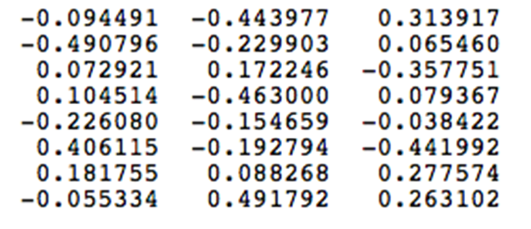
The output to the hidden layer
W=
$h^{t}$ = ½ [ [0 0 0 0 0 1 0 0] + [0 0 0 0 0 0 1 0]] X W
= ½ x[0.58787 -0.104526 -0.164418]
= [0.293935 -0.052263 -0.082209]

Slide 51
The activation vector for output layer neurons
H^{t} ·W’ = [0.293935 -0.052263 -0.082209] x W’
W’ =
H^{t} ·W’ = [-0.008712 0.088894 0.101997 0.119813 -0.074132 -0.017648 0.063706 -0.073282]
Since the goal is produce probabilities for words in the output layer, softmax function is used

Slide 52
The output of the output layer
Thus, the probabilities for eight words in the corpus are:
Python code:
import numpy as np
z = np.array([-0.008712, 0.088894, 0.101997, 0.119813, -0.074132, -0.017648, 0.063706, -0.073282])
Print(np.exp(z)/sum(np.exp(z)))
[0.12052403 0.13288115 0.13463375 0.13705388 0.11289172 0.11945182 0.12957594 0.11298772]

Slide 53
The probability of the target words
With the given W and W’, the first training {the, saw} -> dog we have,
[0.12052403 0.13288115 0.13463375 0.13705388 0.11289172 0.11945182 0.12957594 0.11298772]
The above shows that the probability (in bold) is for the chosen target word “dog” given the target vector
[0 0 0 0 1 0 0 0]^{t}
The error vector for the output layer is easily computed by subtracting the probability vector from the target vector.

Slide 54
Update W and W’ with backpropagation
Once the error is known, the weights in the matrices W and W’ can be updated using backpropagation.
Thus, the training can proceed by presenting different context-target words pair from the corpus.
In essence, this is how Word2vec learns relationships between words and in the process develops vector representations for words in the corpus.

Slide 55
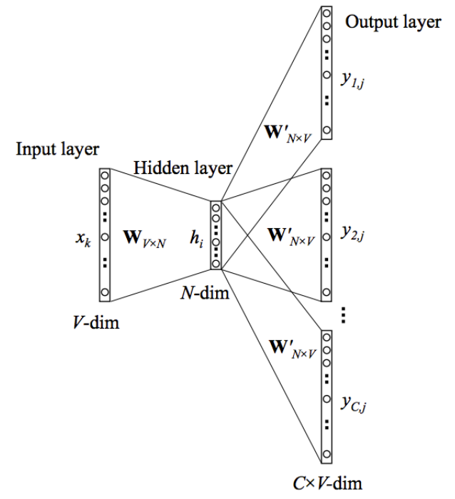
SKIPGRAM
The skipgram model learns to predict a target word using nearby words. It is almost mirror CBOW model.
The skipgram model mirrors CBOW model with the inputs and outputs reversed.
The input layer is the target word x and the out layer is the context words in “one-hot” encode.
Training is to learn W and W’

Slide 56
Language modelling

Slide 57
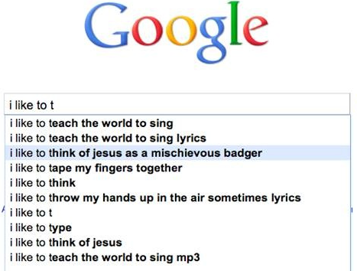
The basic idea
Google auto-completion
Search data from a database
Auto form filling

Slide 58
The basic idea
If we can remember all the data we have in DB (history), we can guess (sure) what is the next if we have the beginning…
If we the complete legal (or illegal) sentences, we will know the rest from a start.
If we understand the entire representation (of information), we can understand the needs (of information) and we know the meaning.

Slide 59
What is a language modelling
If we can figure out how a language is constructed and we should have no problem to understand it (apart from words).
So, “A language model is a probability distribution over sequences of words.”
Jurafsky, Dan; Martin, James H. (2021). "N-gram Language Models". Speech and Language Processing (3rd ed.). Retrieved 24 May 2022.
Given such a sequence of length m, a language model assigns a probability$P(w_{1}, {…, w}_{m})$ to the whole sequence.
… But languages can be used to express an infinite variety of valid sentences
It is impassable to have a precise Math model (fixed model) to compute this probability distribution
Machine learning (NN, deep learning) make it possible …

Slide 60
Language modelling example
Example: Next-word prediction feature of a smartphone keyboard.
A language model can take a list of words (let’s say two words), and attempt to predict the word that follows them.

Slide 61
Language models
BERT
Transformer
PyTorch?
GPT2
GPT3
GTP3 talk about language model
https://www.youtube.com/watch?v=YGckfRuIYW8
In May 2020, OpenAI announced GPT-3, a direct result of applying the scaling laws. The unprecedentedly big 175-billion-parameter LLM put OpenAI ahead of everyone else.
A single training run of GPT-3 cost OpenAI $5–12M.

Slide 62
How language model is used?
Output a list of suggestions (“not” being the one with the highest probability)

Slide 63
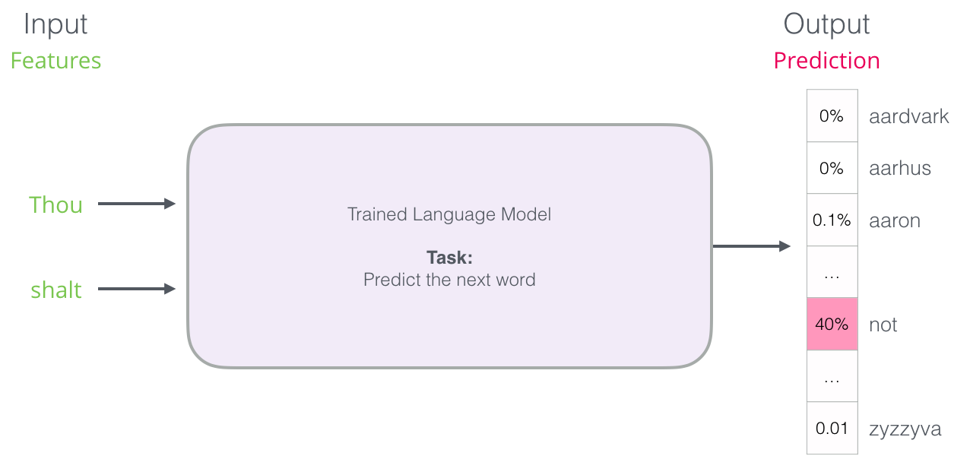
A language model
Outputs a probability score for all the possible words

Slide 64
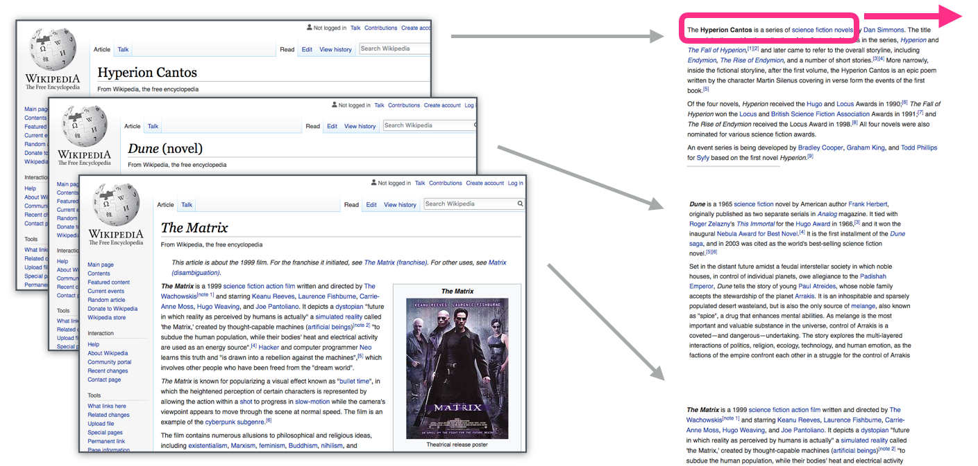
How Language Model is Trained?
We get a lot of text data (say, all Wikipedia articles, for example). then
We have a window (say, of three words) that we slide against all of that text.
The sliding window generates training samples for our model

Slide 65
Language model applications
Needed in,
computational linguistics;
speech recognition^{[2]}
machine translation^{[3]}
natural language generation;
handwriting recognition,^{[4]}
grammar induction,^{[5]}
information retrieval,^{[6][7]}

Slide 66
LLM (Large Language model)
Driven by The scaling laws of large models, from mid-2021 to mid-2022 [company: model (size, release date)]:
Google: LaMDA (137B, May 2021), and PaLM (540B, Apr 2022)
Meta: OPT (175B, May 2022), and BlenderBot 3 (175B, Aug 2022)
DeepMind: Gopher (280B, Dec 2021), and Chinchilla (70B, Apr 2022)
Microsoft-Nvidia: MT-NLG (530B, Oct 2021)
BigScience: BLOOM (176B, June 2022)
Baidu: PCL-BAIDU Wenxin (260B, Dec 2021)
Yandex: YaLM (100B, June 2022)
Tsinghua: GLM (130B, July 2022)
AI21 labs: Jurassic-1 (178B, Aug 2021)
Aleph Alpha: Luminous (200B, Nov 2021)

Slide 67
LLM landscape

Slide 68
Readings
https://jalammar.github.io/illustrated-word2vec/
https://www.youtube.com/watch?v=NAihcvDGaP8
https://albertoromgar.medium.com/ultra-large-ai-models-are-over-c7b5fc007d0a

Slide 69
The last of language model
Google LaMDA
https://www.youtube.com/watch?v=NAihcvDGaP8
LaMDA | Is google's AI sentient? | Full audio conversation between Blake Lemoine and LaMDA

